Slide 1





Decoupling of bound states with the Magnus expansion and the IM-SRG
Anthony Tropiano (OSU)
Scott Bogner (MSU), Dick Furnstahl (OSU), Nathan Parzuchowski (OSU)
APS April Meeting 2018, Columbus, Ohio
April 14, 2018
Undergrad $→$ Grad

Slide 2
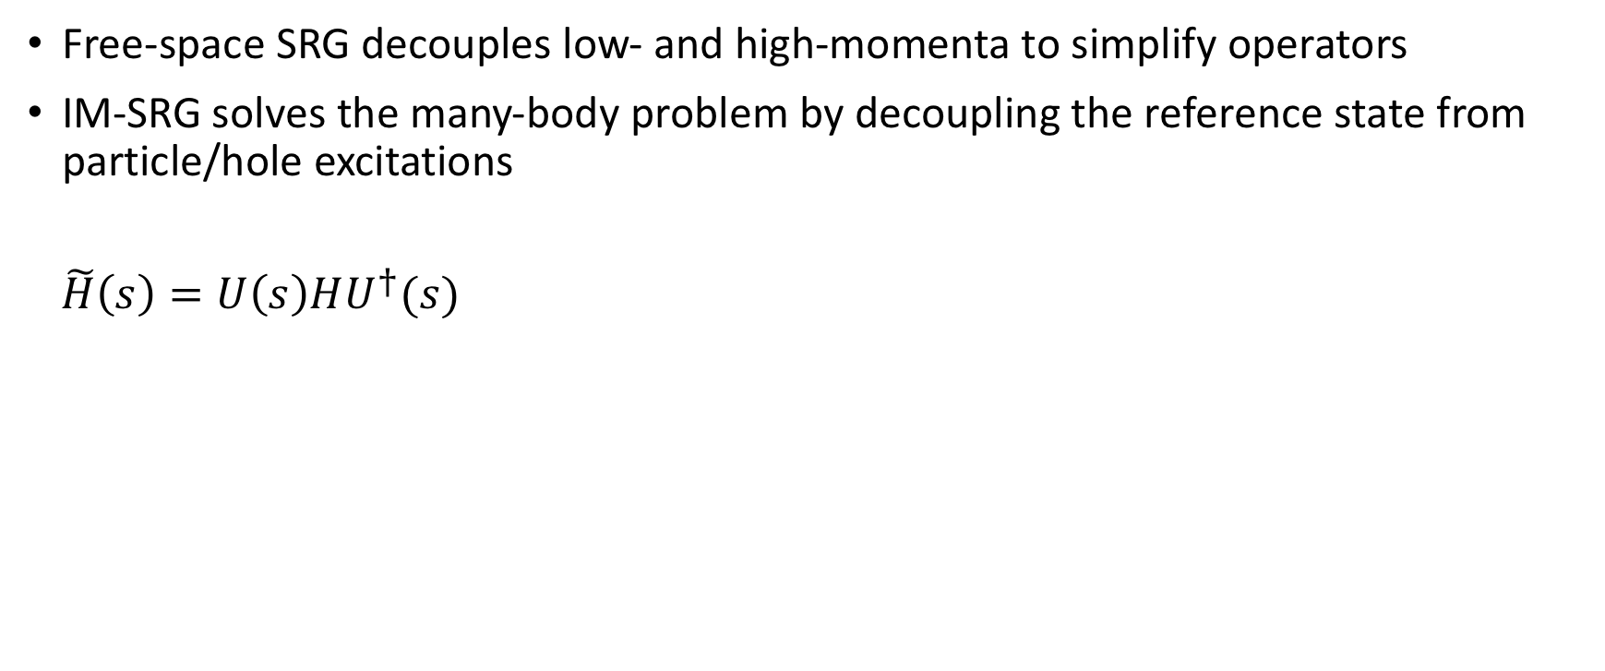
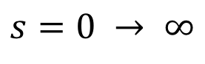
In-medium similarity renormalization group (IM-SRG)
Free-space SRG decouples low- and high-momenta to simplify operators
IM-SRG solves the many-body problem by decoupling the reference state from particle/hole excitations
$\tilde{H}\left(s\right)=U\left(s\right)HU^{†}(s)$
$$s=0 → ∞$$
Figure from Nathan Parzuchowski

Slide 3
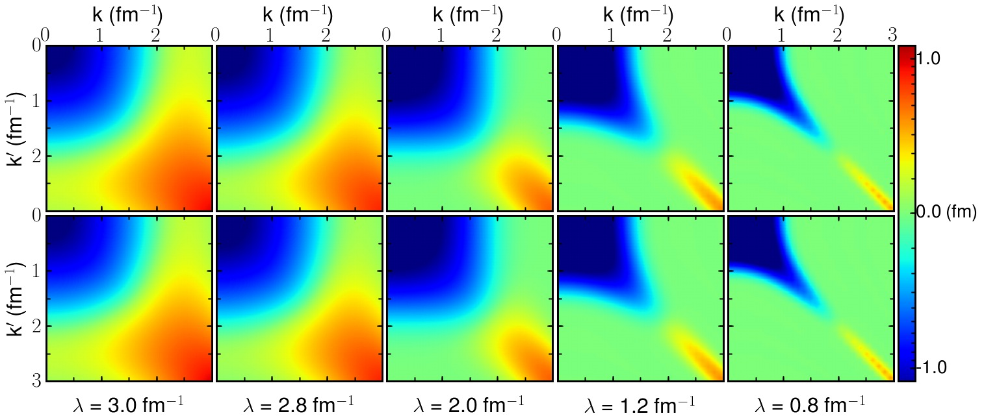
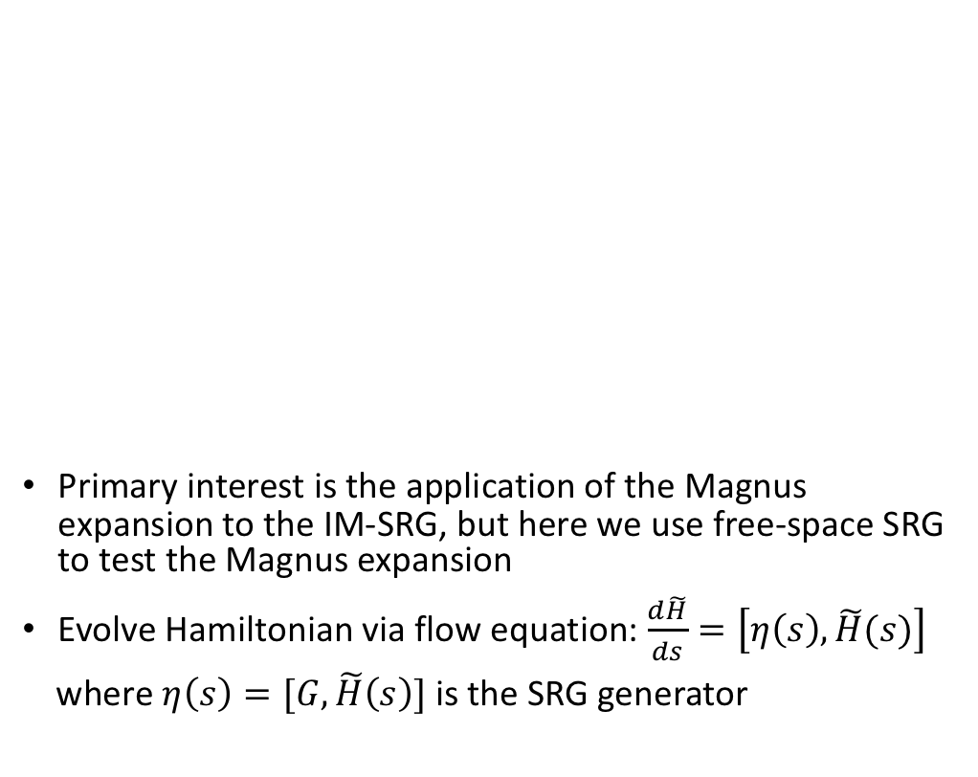
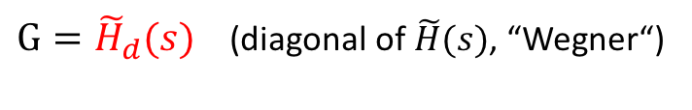
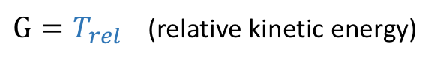
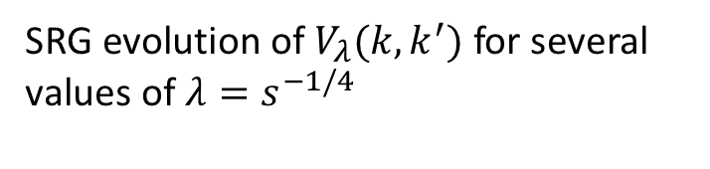
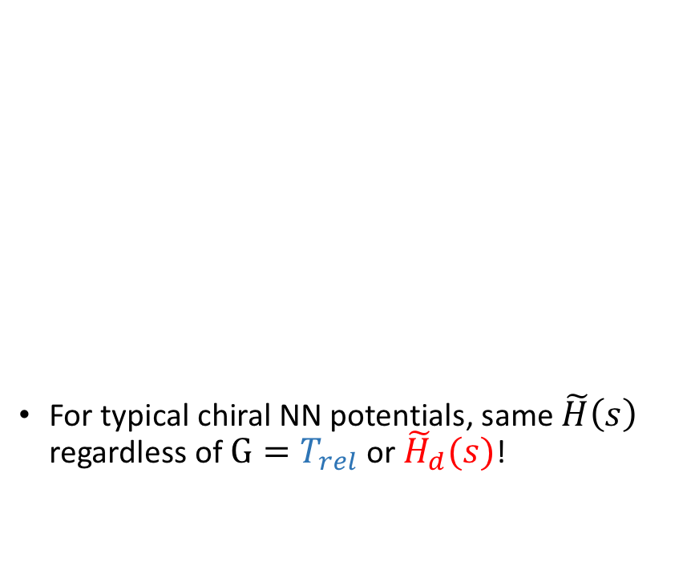
SRG formalism
SRG evolution of $V_{λ}(k,k^{′})$ for several values of $λ=s^{−1/4}$
Primary interest is the application of the Magnus expansion to the IM-SRG, but here we use free-space SRG to test the Magnus expansion
Evolve Hamiltonian via flow equation: $\frac{d\tilde{H}}{ds}=\left[η\left(s\right),\tilde{H}(s)\right]$
where $η\left(s\right)=[G,\tilde{H}\left(s\right)]$ is the SRG generator
For typical chiral NN potentials, same $\tilde{H}\left(s\right)$ regardless of $G=T_{rel}$ or ${\tilde{H}}_{d}(s)$!
$G=T_{rel}$ (relative kinetic energy)
$G={\tilde{H}}_{d}(s)$ (diagonal of $\tilde{H}(s)$, “Wegner“)
Figure from K.A. Wendt, R.J. Furnstahl, R.J. Perry, Phys. Rev. C 83, 034005 (2011)

Slide 4
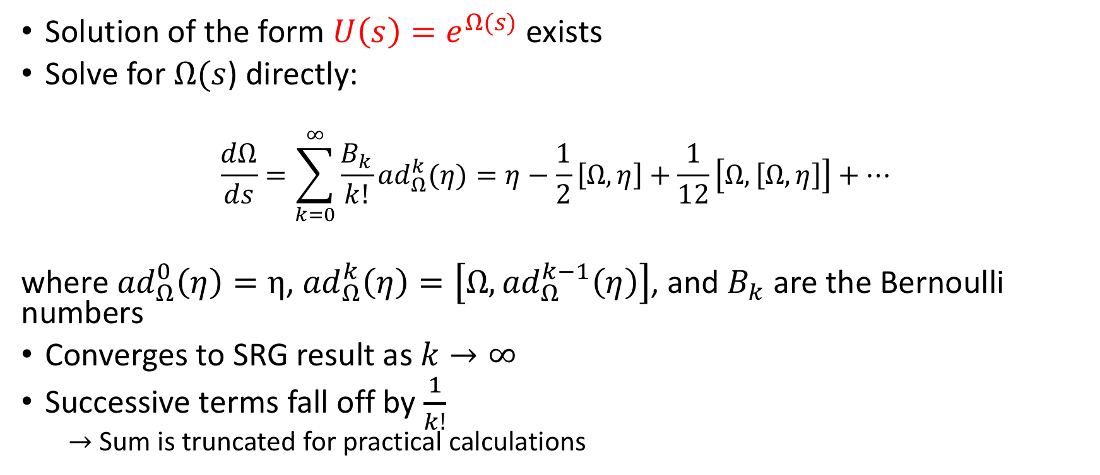
The Magnus Expansion: Formalism
Solution of the form $U\left(s\right)=e^{Ω(s)}$ exists
Solve for $Ω(s$) directly:
$$\frac{dΩ}{ds}=\sum_{k=0}^{∞}{\frac{B_{k}}{k!}{ad}_{Ω}^{k}(η)}=η−\frac{1}{2}\left[Ω,η\right]+\frac{1}{12}\left[Ω,\left[Ω,η\right]\right]+…$$
where ${ad}_{Ω}^{0}\left(η\right)=η$, ${ad}_{Ω}^{k}\left(η\right)=\left[Ω,{ad}_{Ω}^{k−1}\left(η\right)\right]$, and $B_{k}$ are the Bernoulli numbers
Converges to SRG result as $k→∞$
Successive terms fall off by $\frac{1}{k!}$
$→$ Sum is truncated for practical calculations

Slide 5
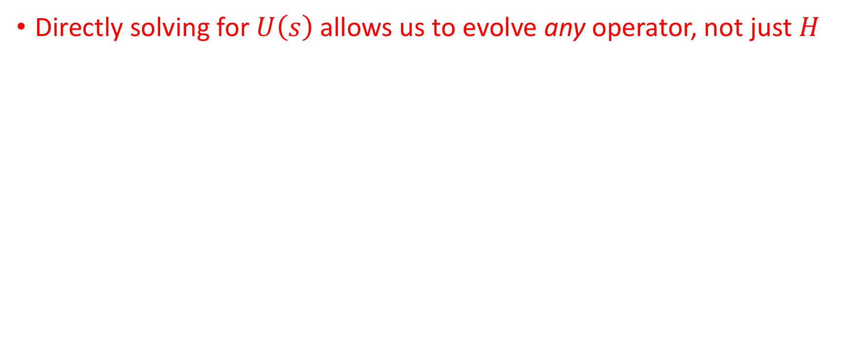
The Magnus Expansion: Motivation
Directly solving for $U\left(s\right)$ allows us to evolve any operator, not just $H$

Slide 6
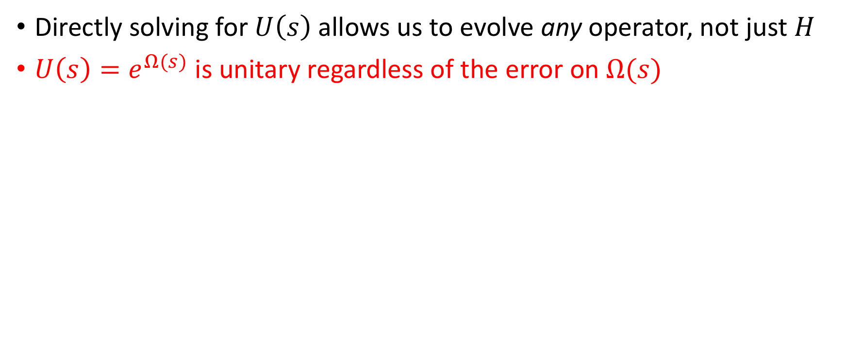
The Magnus Expansion: Motivation
Directly solving for $U\left(s\right)$ allows us to evolve any operator, not just $H$
$U\left(s\right)=e^{Ω(s)}$ is unitary regardless of the error on $Ω(s)$

Slide 7
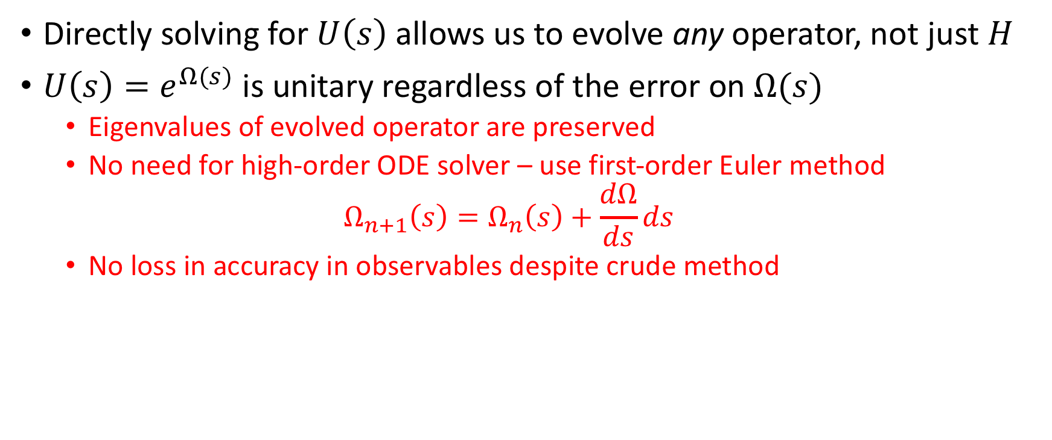
The Magnus Expansion: Motivation
Directly solving for $U\left(s\right)$ allows us to evolve any operator, not just $H$
$U\left(s\right)=e^{Ω(s)}$ is unitary regardless of the error on $Ω(s)$
Eigenvalues of evolved operator are preserved
No need for high-order ODE solver – use first-order Euler method
$$Ω_{n+1}\left(s\right)=Ω_{n}\left(s\right)+\frac{dΩ}{ds}ds$$
No loss in accuracy in observables despite crude method

Slide 8
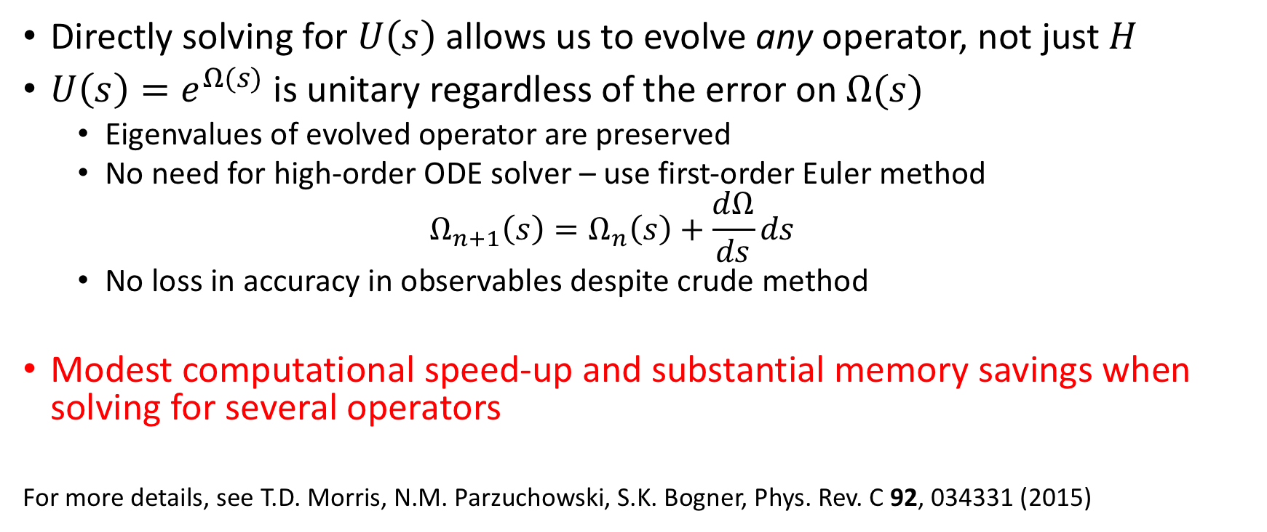
The Magnus Expansion: Motivation
Directly solving for $U\left(s\right)$ allows us to evolve any operator, not just $H$
$U\left(s\right)=e^{Ω(s)}$ is unitary regardless of the error on $Ω(s)$
Eigenvalues of evolved operator are preserved
No need for high-order ODE solver – use first-order Euler method
$$Ω_{n+1}\left(s\right)=Ω_{n}\left(s\right)+\frac{dΩ}{ds}ds$$
No loss in accuracy in observables despite crude method
Modest computational speed-up and substantial memory savings when solving for several operators
For more details, see T.D. Morris, N.M. Parzuchowski, S.K. Bogner, Phys. Rev. C 92, 034331 (2015)

Slide 9

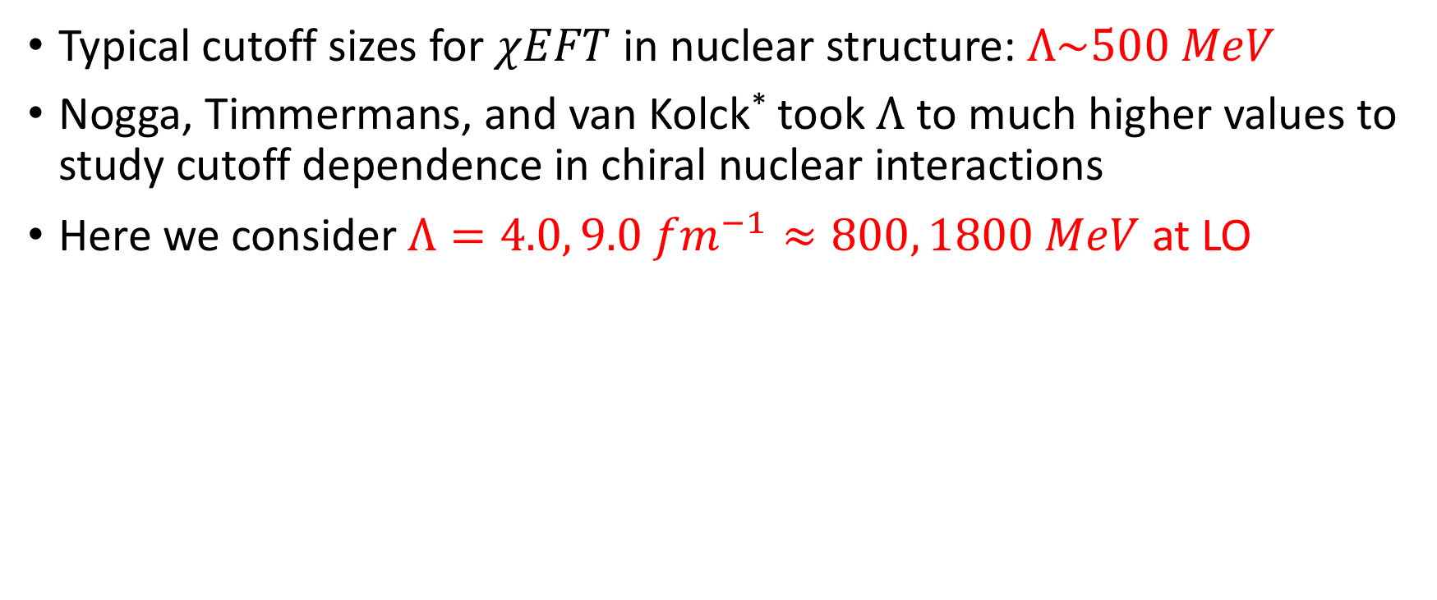
Test Case: NN potentials with large $χ$EFT cutoffs
Typical cutoff sizes for $χEFT$ in nuclear structure: $Λ\sim 500 MeV$
Nogga, Timmermans, and van Kolck* took $Λ$ to much higher values to study cutoff dependence in chiral nuclear interactions
Here we consider $Λ=4.0, 9.0 {fm}^{−1}≈800, 1800 MeV$ at LO
*A. Nogga, R.G.E. Timmermans, and U. van Kolck, Phys. Rev. C 72, 054006 (2005)

Slide 10
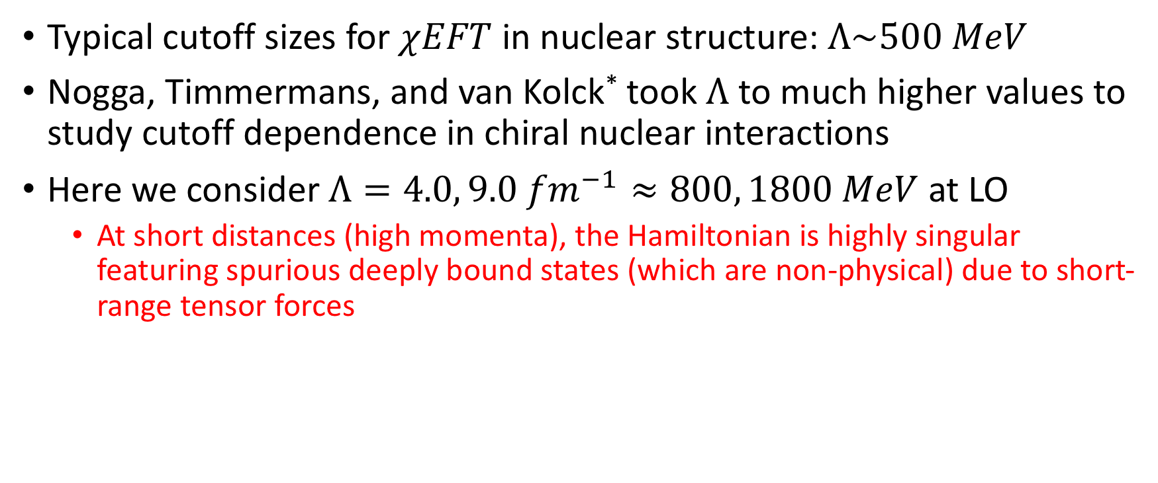
Test Case: NN potentials with large $χ$EFT cutoffs
Typical cutoff sizes for $χEFT$ in nuclear structure: $Λ\sim 500 MeV$
Nogga, Timmermans, and van Kolck* took $Λ$ to much higher values to study cutoff dependence in chiral nuclear interactions
Here we consider $Λ=4.0, 9.0 {fm}^{−1}≈800, 1800 MeV$ at LO
At short distances (high momenta), the Hamiltonian is highly singular featuring spurious deeply bound states (which are non-physical) due to short-range tensor forces
*A. Nogga, R.G.E. Timmermans, and U. van Kolck, Phys. Rev. C 72, 054006 (2005)

Slide 11
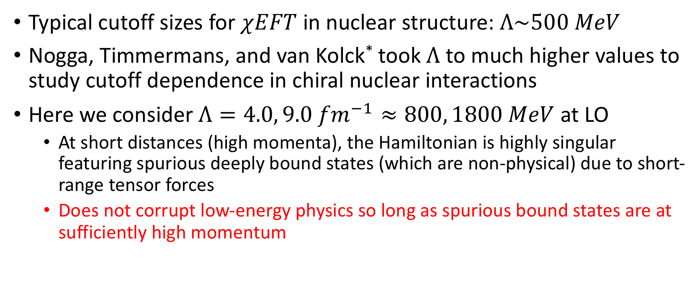
Test Case: NN potentials with large $χ$EFT cutoffs
Typical cutoff sizes for $χEFT$ in nuclear structure: $Λ\sim 500 MeV$
Nogga, Timmermans, and van Kolck* took $Λ$ to much higher values to study cutoff dependence in chiral nuclear interactions
Here we consider $Λ=4.0, 9.0 {fm}^{−1}≈800, 1800 MeV$ at LO
At short distances (high momenta), the Hamiltonian is highly singular featuring spurious deeply bound states (which are non-physical) due to short-range tensor forces
Does not corrupt low-energy physics so long as spurious bound states are at sufficiently high momentum
*A. Nogga, R.G.E. Timmermans, and U. van Kolck, Phys. Rev. C 72, 054006 (2005)

Slide 12
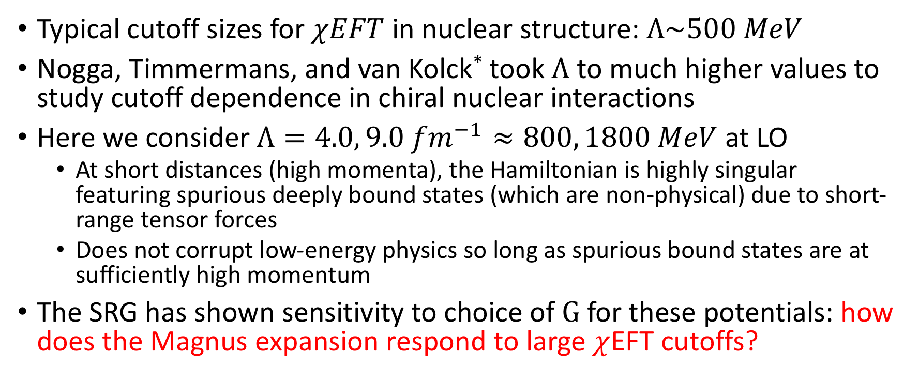
Test Case: NN potentials with large $χ$EFT cutoffs
Typical cutoff sizes for $χEFT$ in nuclear structure: $Λ\sim 500 MeV$
Nogga, Timmermans, and van Kolck* took $Λ$ to much higher values to study cutoff dependence in chiral nuclear interactions
Here we consider $Λ=4.0, 9.0 {fm}^{−1}≈800, 1800 MeV$ at LO
At short distances (high momenta), the Hamiltonian is highly singular featuring spurious deeply bound states (which are non-physical) due to short-range tensor forces
Does not corrupt low-energy physics so long as spurious bound states are at sufficiently high momentum
The SRG has shown sensitivity to choice of $G$for these potentials: how does the Magnus expansion respond to large $χ$EFT cutoffs?
*A. Nogga, R.G.E. Timmermans, and U. van Kolck, Phys. Rev. C 72, 054006 (2005)

Slide 13
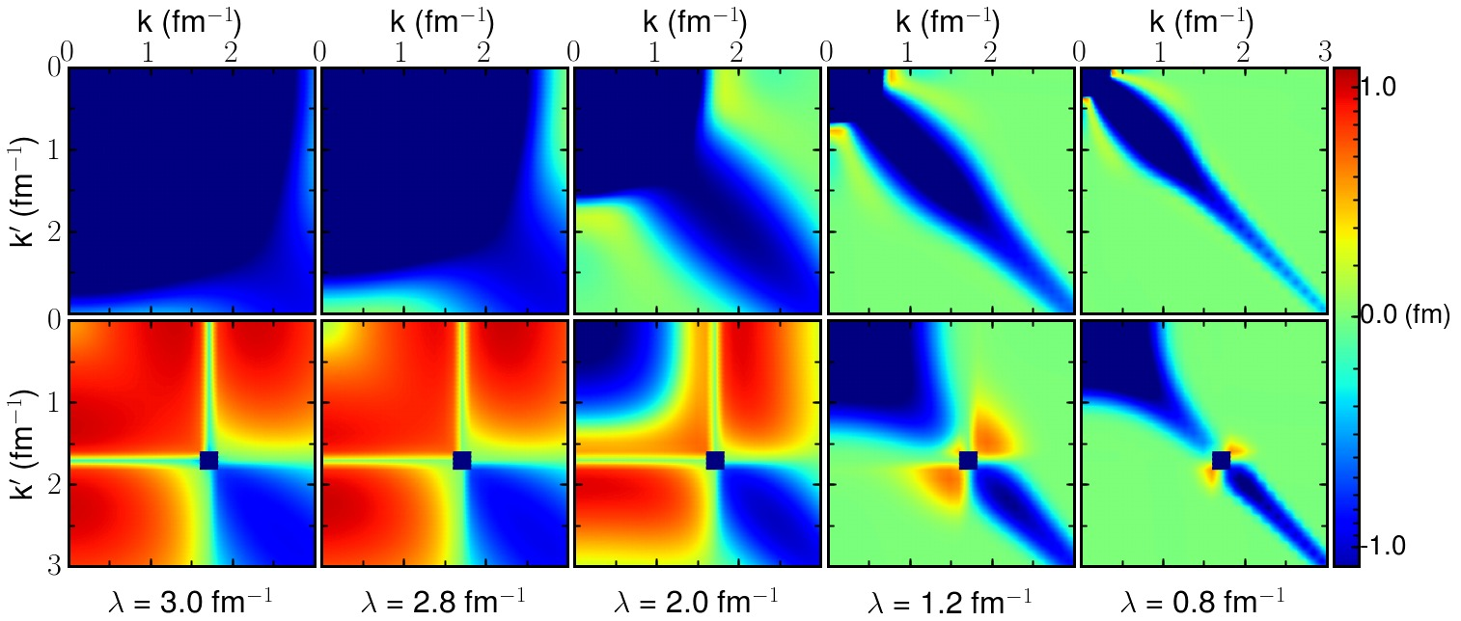
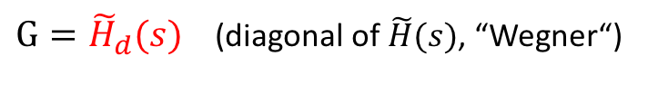


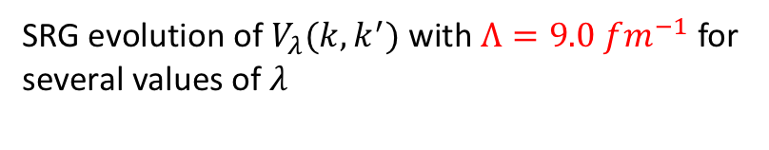
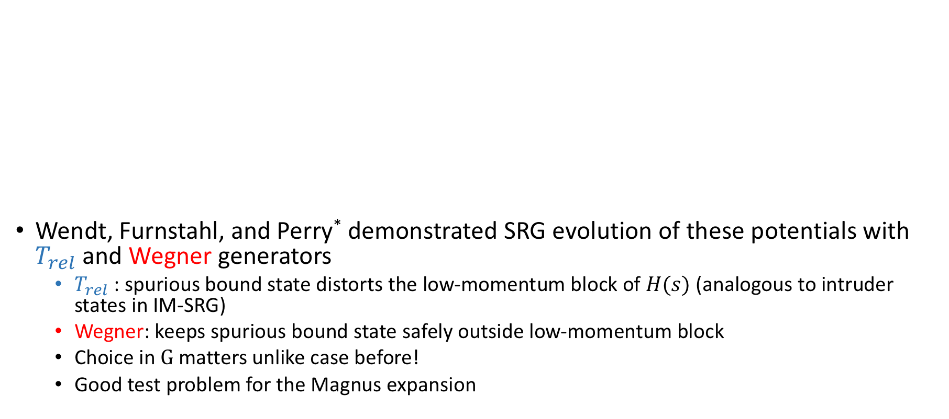
Test Case: NN potentials with large $χ$EFT cutoffs cont…
SRG evolution of $V_{λ}(k,k^{′})$ with $Λ=9.0 {fm}^{−1}$for several values of $λ$
Wendt, Furnstahl, and Perry* demonstrated SRG evolution of these potentials with $T_{rel}$ and Wegner generators
$T_{rel}$: spurious bound state distorts the low-momentum block of $H(s)$ (analogous to intruder states in IM-SRG)
Wegner: keeps spurious bound state safely outside low-momentum block
Choice in $G$ matters unlike case before!
Good test problem for the Magnus expansion
$G=T_{rel}$ (relative kinetic energy)
$G={\tilde{H}}_{d}(s)$ (diagonal of $\tilde{H}(s)$, “Wegner“)
Figure from *K.A. Wendt, R.J. Furnstahl, R.J. Perry, Phys. Rev. C 83, 034005 (2011)

Slide 14
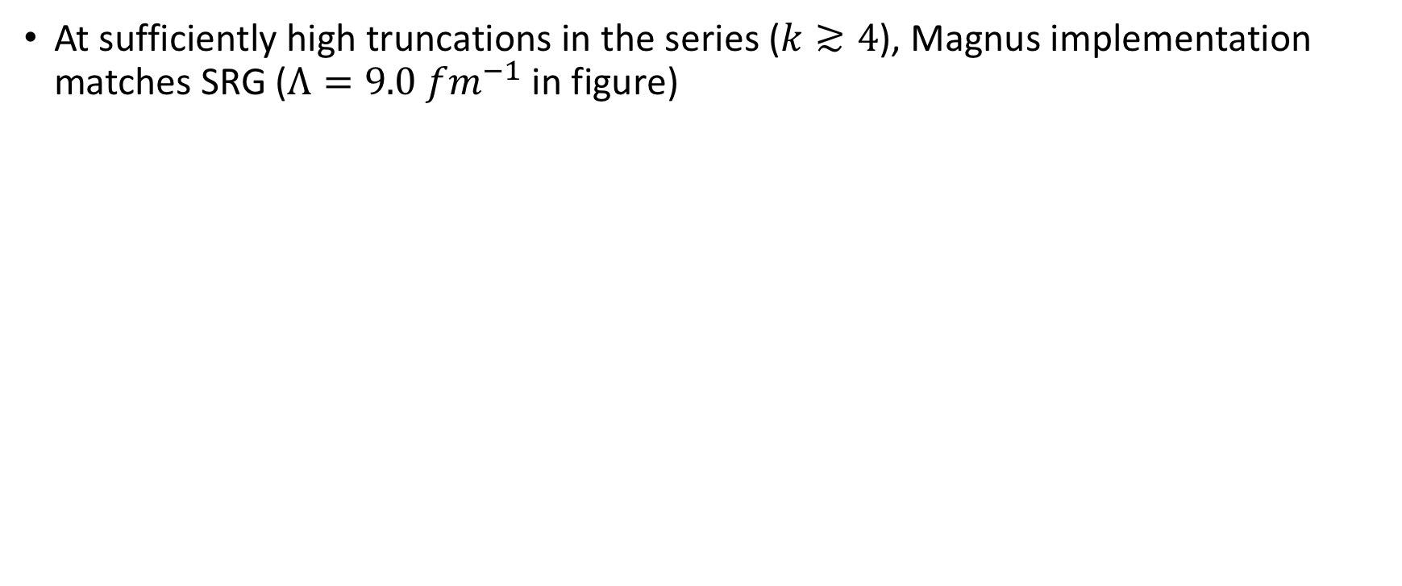
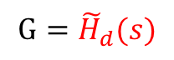
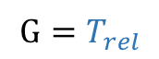
Results: Magnus v. typical SRG
At sufficiently high truncations in the series ($k≳4$), Magnus implementation matches SRG ($Λ=9.0 {fm}^{−1}$ in figure)
$$G={\tilde{H}}_{d}(s)$$
$$G=T_{rel}$$

Slide 15
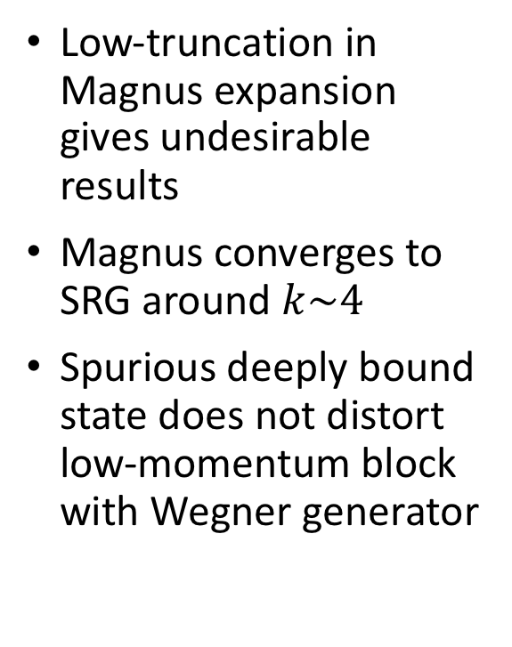
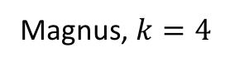
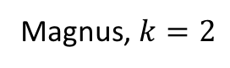
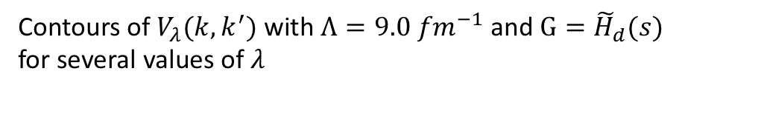
Results: Truncation of series
Low-truncation in Magnus expansion gives undesirable results
Magnus converges to SRG around $k\sim 4$
Spurious deeply bound state does not distort low-momentum block with Wegner generator
Magnus, $k=2$
Magnus, $k=4$
SRG
Contours of $V_{λ}(k,k^{′})$ with $Λ=9.0 {fm}^{−1}$and $G={\tilde{H}}_{d}(s)$
for several values of $λ$

Slide 16
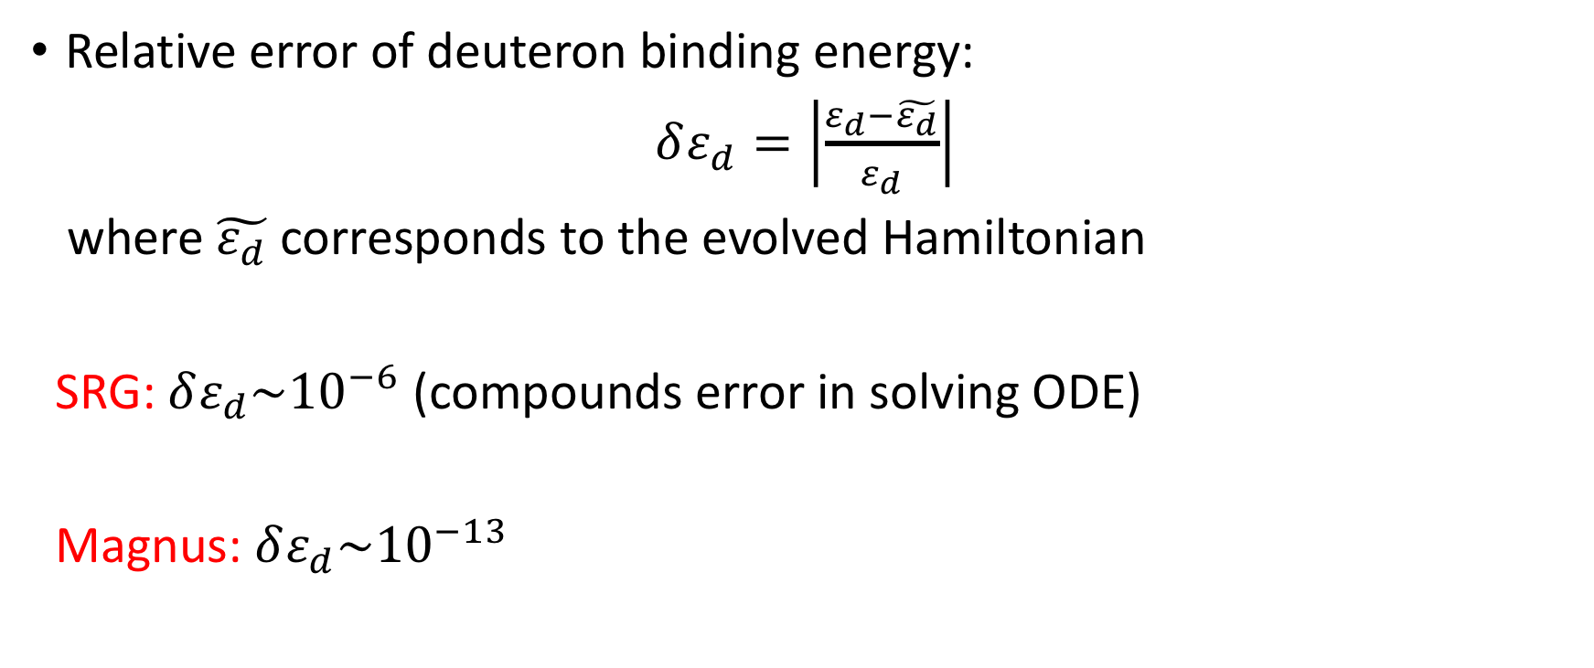
Results: Accuracy of observables
Relative error of deuteron binding energy:
$δε_{d}=\left|\frac{ε_{d}−\tilde{ε_{d}}}{ε_{d}}\right|$
where $\tilde{ε_{d}}$ corresponds to the evolved Hamiltonian
SRG: $δε_{d}\sim {10}^{−6}$ (compounds error in solving ODE)
Magnus: $δε_{d}\sim {10}^{−13}$

Slide 17
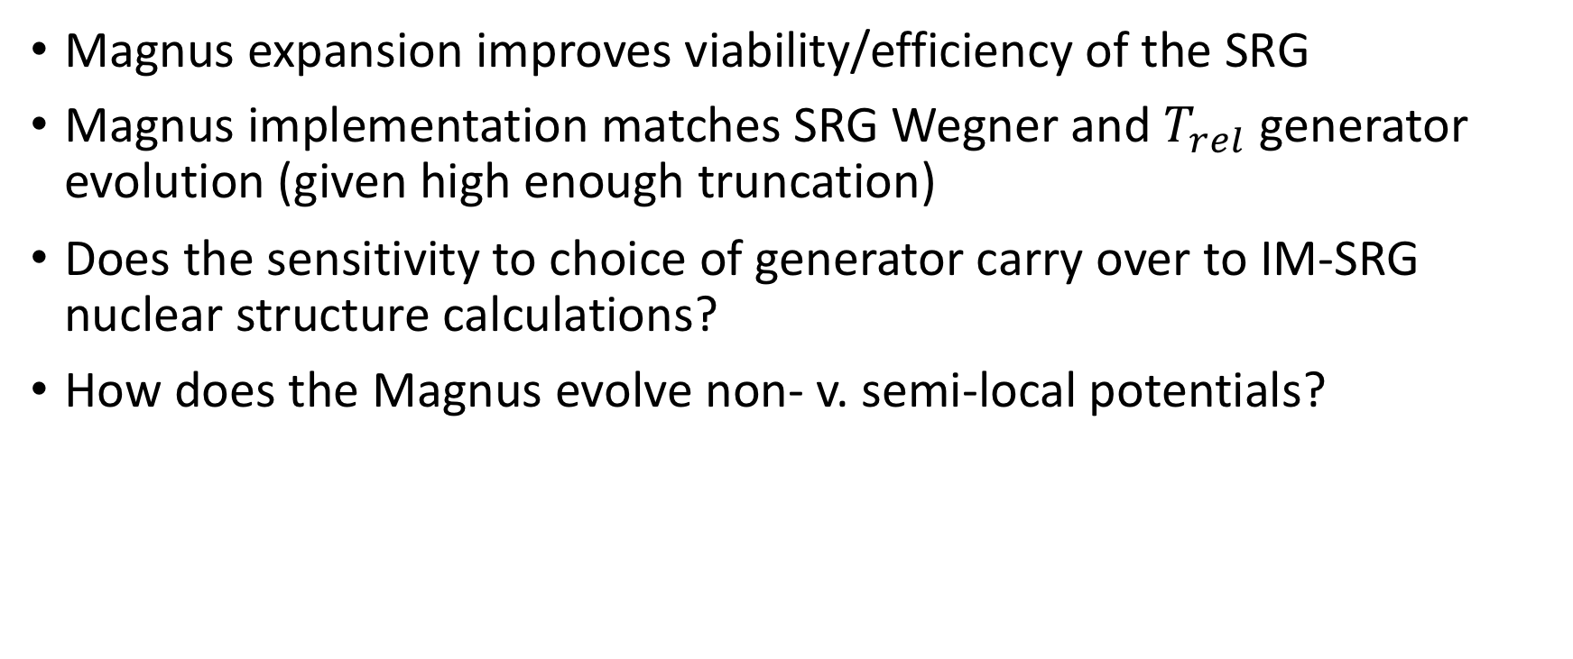
Summary and outlook
Magnus expansion improves viability/efficiency of the SRG
Magnus implementation matches SRG Wegner and $T_{rel}$ generator evolution (given high enough truncation)
Does the sensitivity to choice of generator carry over to IM-SRG nuclear structure calculations?
How does the Magnus evolve non- v. semi-local potentials?

Slide 18
Back-up slides
Several phenomenological NN potentials (left) and momentum-space matrix elements of AV18 (right)
Figure from S.K. Bogner, R.J. Furnstahl, and A. Schwenk, Prog. Part. Nucl. Phys. 65, 94 (2010)

